Slide 1

Introduction to

Slide 2
Onderwerpen Dag 1
Achtergronden en historie van R
Hulp krijgen, de R community
Werken met de commandline en Rstudio
Installeren van packages
Markdown en Reproducible research
Datatypes in R
Diverse operatoren in R
Lezen en schrijven van tekstbestanden
Data importeren en exporteren (excel, spss, sas, stata)
Omgaan met ontbrekende data (NA’s)
Verschillende datastructuren (vector, matrix, array en list)
Omgaan met vectoren (kolommen) en data.frames (tabeldata)
Omgaan met factors
Sampling en sorteren
Selecteren, invoegen en verwijderen van rijen en kolommen
Converteren en hernoemen van variabelen
Subsetting (subset, in which, any, all)

Slide 3
Leerdoelen
Aan een collega uitleggen wat de historie van R is.
R installeren
Werken met Rstudio
Eenvoudig hulp opvragen
Werken packages
Markdown files genereren
Werken met de verschillende objecten en datatypes
Ken je de standaard operatoren en kun je ze toepassen
Datasets uit bijvoorbeeld csv bestanden lezen
Datasets uit bestanden van andere pakketten (bijvoorbeeld SPSS) openen
Omgaan met missing data NA's
Begrijp je het verschil, maar ook de samenhang tussen een vector, matrix en dataframe
Aangeven wat voor type programmeertaal R is

Slide 4
Onderwerpen Dag 2
R graphics
Histogram
Boxplot
Plot characters en bins aanpassen
Overlays in plots
Flow of control
Conditionele flows (if, else, switch)
Iteratieve flows (for, while, repeat)
Schrijven van eigen functies
Functies als parameters
De 'apply' familie (apply, sapply, tapply)
Calling conventions
Werken met standaard argumenten
Lazy evalutation en scoping
Foutopsporing en debugging

Slide 5
Leerdoelen
Eenvoudige plots maken
Met branching (if) en looping (for) werken
Eigen functies maken
Functies als objecten gebruiken
De apply famile toepassen
Begrijp je late evaluation
Debuggen
If, else en iteratieve bewegingen toepassen

Slide 6
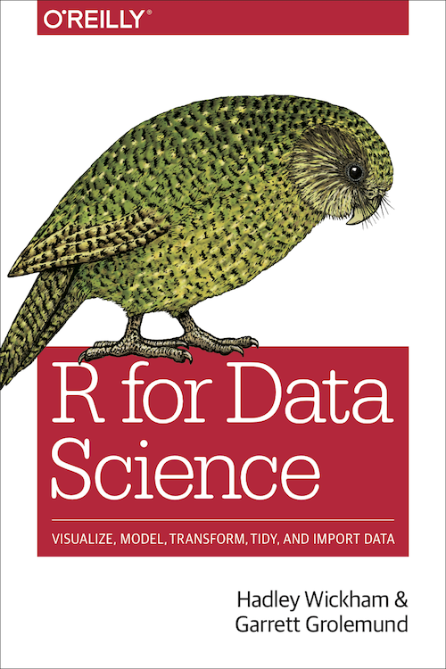
Materiaal
https://r4ds.had.co.nz/index.html

Slide 7
Links
https://r4ds.had.co.nz/index.html R for Data Science
https://www.r-project.org/about.html
https://www.w3schools.com/r/default.asp
https://www.javatpoint.com/r-tutorial
https://www.tutorialspoint.com/r/index.htm
https://www.geeksforgeeks.org/r-tutorial/?ref=lbp
https://www.atnyla.com/tutorial/about-r-tutorial/7/409
http://applied-r.com/

Slide 8
R
R is ‘GNU S’, a freely available language and environment for statistical computing and graphics which provides a wide variety of statistical and graphical techniques: linear and nonlinear modelling, statistical tests, time series analysis, classification, clustering, etc.

Slide 9
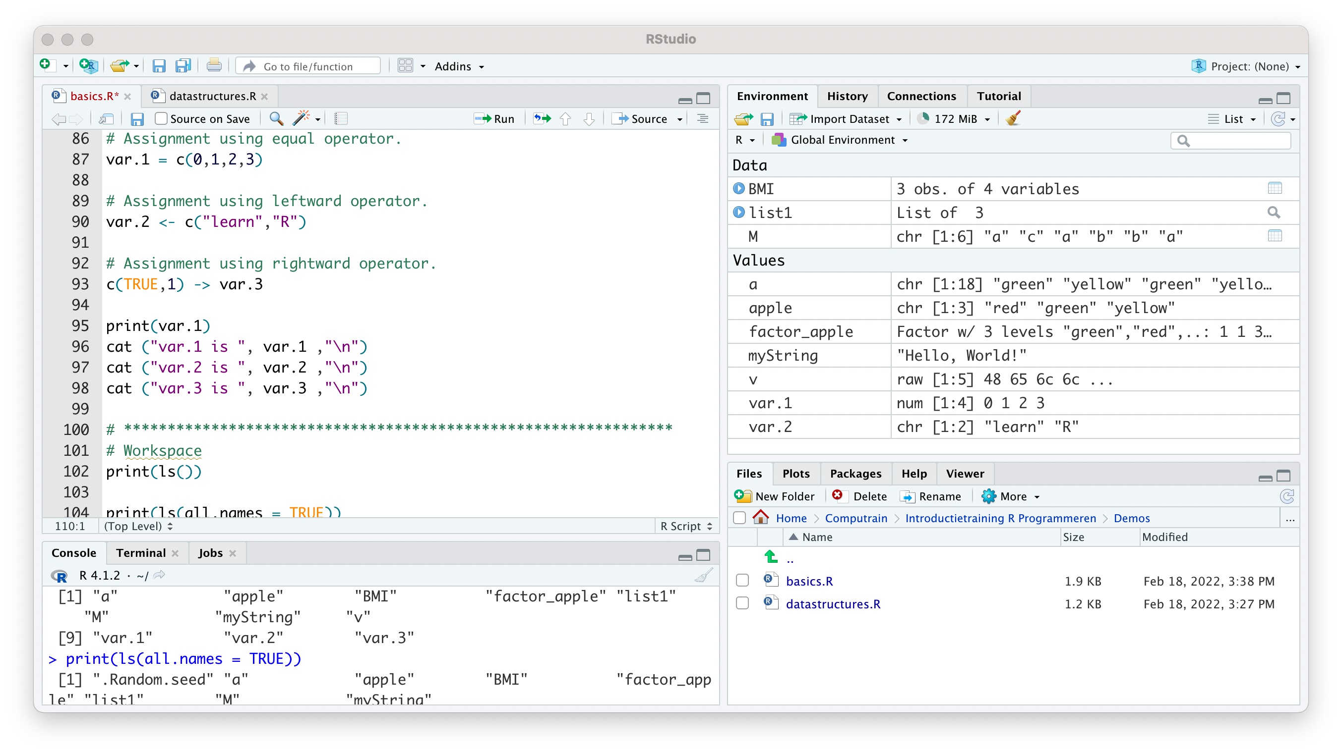
Rstudio
Editor
Console
Terminal
Environment
Files
Plots
Packages
Help
Notes:
?
help()
vignette()

Slide 10
Datastructures
Vector
List
Matrice
Array
Factor
Data Frame

Slide 11
Vector
6 Data Types of these atomic vectors:
Logical TRUE, FALSE
Numeric 12.3, 5, 999
Integer 2L, 34L, 0L
Complex 3 + 2i
Character 'a' , '"good", "TRUE", '23.4'
Raw
Create a vector with more than one element with c()

Slide 12
List
A list is an R-object which can contain many different types of elements inside it like vectors, functions and even another list inside it.

Slide 13
Matrix
A matrix is a two-dimensional rectangular data set. It can be created using a vector input to the matrix function.

Slide 14
Array
While matrices are confined to two dimensions, arrays can be of any number of dimensions. The array function takes a dim attribute which creates the required number of dimension.

Slide 15
Factor
Factors are the r-objects which are created using a vector. It stores the vector along with the distinct values of the elements in the vector as labels. The labels are always character irrespective of whether it is numeric or character or Boolean etc. in the input vector.
Categorical data
x <- factor(c("single", "married", "married", "single"),
levels = c("single", "married", "divorced"));

Slide 16
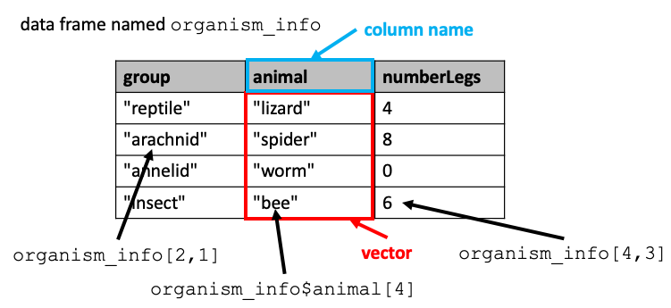
Data Frame
Data frames are tabular data objects. Unlike a matrix in data frame each column can contain different modes of data. The first column can be numeric while the second column can be character and third column can be logical. It is a list of vectors of equal length.

Slide 17
Variable
A variable provides us with named storage that our programs can manipulate
A valid variable name consists of letters, numbers and the dot or underline characters. The variable name starts with a letter or the dot not followed by a number.
The variables can be assigned values using leftward, rightward and equal to operator.
In R, a variable itself is not declared of any data type, rather it gets the data type of the R - object assigned to it. So R is called a dynamically typed language, which means that we can change a variable’s data type of the same variable again and again when using it in a program.

Slide 18
Workspace
To know all the variables currently available in the workspace we use the ls() function.
The ls() function can use patterns to match the variable names with the pattern argument.
The variables starting with dot(.) are hidden, they can be listed using "all.names = TRUE" argument to ls() function.
Variables can be deleted by using the rm() function.

Slide 19
Operators
Arithmetic Operators
Relational Operators
Logical Operators
Assignment Operators
Miscellaneous Operators

Slide 20
Arithmetic Operators
All operations are vectorized!
Addition +
Subtraction -
Multiplication *
Division /
Remainder %%
Floored division %/%
Power ^
Vectorized Operations
Each element of the first vector is compared with the corresponding element of the second vector.

Slide 21
Relational Operators
The result of comparison is a Boolean value (TRUE or FALSE).
Greater >
Greater or equal >=
Less <
Less or equal <=
Equal ==
Not equal !=

Slide 22
Logical Operators
Non-zero value are evaluated to TRUE
Logical And &
Logical Or |
Logical Not !

Slide 23
Assignment Operators
Left Assignment <− = <<−
Right Assignment −> −>>

Slide 24
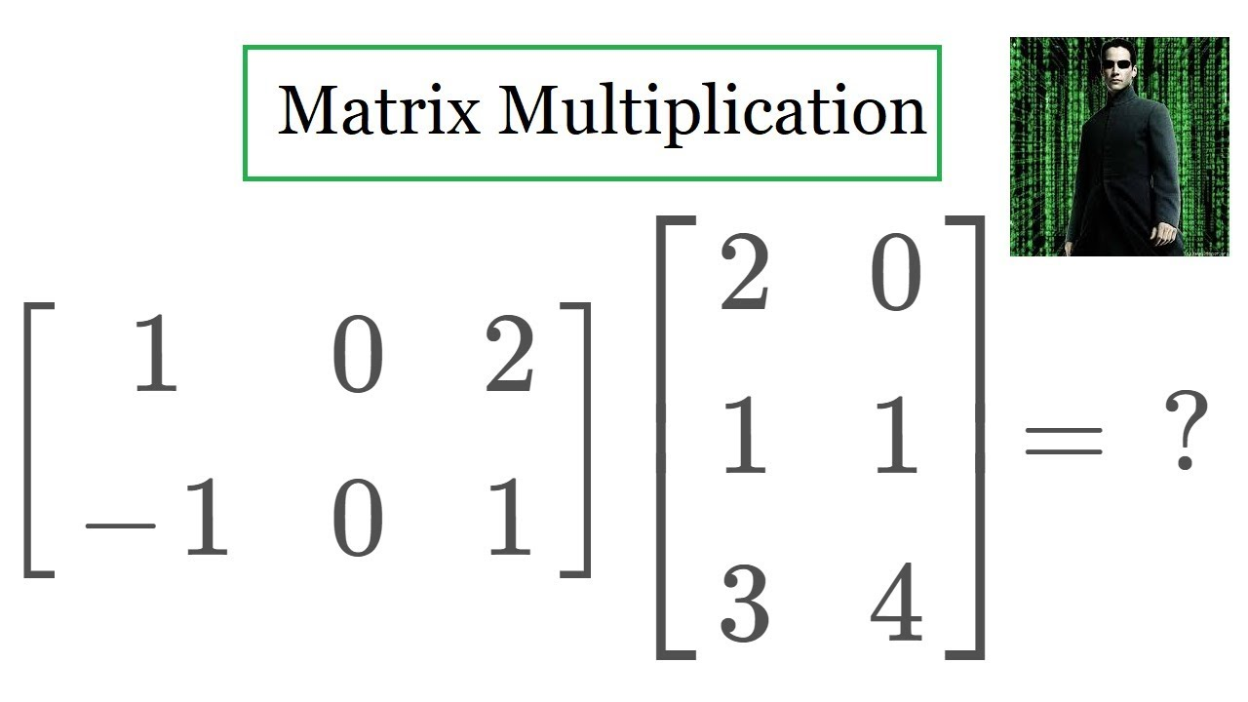
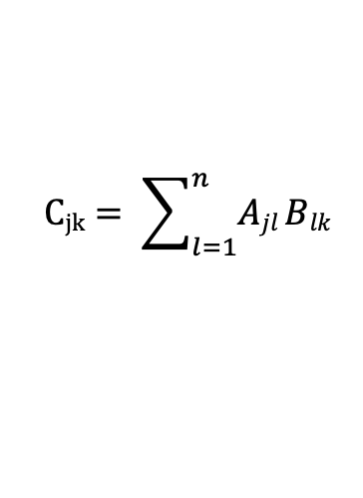
Miscellaneous Operators
Sequence :
In %in%
Matrix multiplication %*%
$$Cjk= \sum_{l=1}^{n}{Ajl Blk}$$
Notes:
⎡ 2 0 ⎤
⎡ 1 0 2 ⎤ ⎢ 1 1 ⎥ ⎡ 8 8 ⎤
⎣ -1 0 1 ⎦ $*$ ⎣ 3 4 ⎦ = ⎣ 1 4 ⎦
⎣ ⎦. ⎡ ⎤. ⎢⎥

Slide 25
Strings
Any value written within a pair of single quote or double quotes in R is treated as a string.
Concatenating Strings paste()
Formatting numbers & strings format()
Counting number of characters in a string nchar()
Changing the case toupper() & tolower()
Extracting parts of a string substring()

Slide 26
Conditional Statements
if statement
if – else statement
switch statement

Slide 27
Loops
repeat loop
Like a while statement, except that it tests the condition at the end of the loop body.
while loop
Repeats a statement or group of statements while a given condition is true. It tests the condition before executing the loop body.
for loop
Executes a sequence of statements multiple times and abbreviates the code that manages the loop variable.
Loop control statements change execution from its normal sequence
break statement
next statement

Slide 28
Functions
A function is a set of statements organized together to perform a specific task.
An R function is created by using the keyword function.
The different parts of a function are
Function Name − This is the actual name of the function.
Arguments − An argument is a placeholder.
Function Body − The function body contains a collection of statements that defines what the function does.
Return Value − The return value of a function is the last expression in the function body to be evaluated.
function_name <- function(arg_1, arg_2, ...) {
Function body
}

Slide 29
Base R functions
Numeric Functions | Character Functions | Statistical Probability Functions | Other Statistical Functions | Other Functions
abs() | substr() | dnorm() | mean() | seq()
sqrt() | grep() | dbinom() | sd() | rep()
ceiling() | sub() | dpois() | median() | cut()
floor() | strsplit() | dunif() | quantile()
trunc() | paste() | dbinom() | range() | print()
round() | toupper() |  | sum()
signif() | tolower() |  | diff() | lappy()
cos(), sin(), tan() |  |  | min() | sapply()
log() |  |  | max() | mapply()
log10() |  |  | scale()
exp()
> library(help = "base")
Notes:
library(help = "base")

Slide 30
Calling a Function
function_name(arg1, arg2, …)
do.call("function_name", arg1, arg2, …)
call("function_name", arg1, arg2, …)
> sum(c(2,3,4))
[1] 9

Slide 31
Documentation
The help() function and ? help operator in R provide access to the documentation pages for R functions, data sets, and other objects, both for packages in the standard R distribution and for contributed packages.
help(topic, package = NULL, lib.loc = NULL,
verbose = getOption("verbose"),
try.all.packages = getOption("help.try.all.packages"),
help_type = getOption("help_type"))
★ https://www.r-project.org/help.html

Slide 32
CRAN
The Comprehensive R Archive Network
CRAN is a network of ftp and web servers around the world that store identical, up-to-date, versions of code and documentation for R.
Mirror NL - https://mirror.lyrahosting.com/CRAN/
function (package, help, pos = 2, lib.loc = NULL,
character.only = FALSE, logical.return = FALSE,
warn.conflicts = TRUE, quietly = FALSE,
verbose = getOption("verbose"))

Slide 33
Libraries
tidyr Tidy Messy Data
dplyr A Grammar of Data Manipulation
caret Classification and Regression Training
cran_mirror <- "https://mirror.lyrahosting.com/CRAN/"
install.packages("caret", repos = cran_mirror)
library(caret)
★ https://cran.r-project.org/web/packages/available_packages_by_name.html
Notes:
https://cran.r-project.org/web/packages/available_packages_by_name.html

Slide 34
Data Frames

Slide 35
Creating a Data Frame
data.frame()
# Create the data frame.
emp.data <- data.frame(
emp_id = c (1:5),
emp_name = c("Rick","Dan","Michelle","Ryan","Gary"),
salary = c(623.3,515.2,611.0,729.0,843.25),
start_date = as.Date(c("2012-01-01", "2013-09-23", "2014-11-15",
"2014-05-11", "2015-03-27")),
stringsAsFactors = FALSE
)
# Print the data frame.
print(emp.data)
Notes:
# Create the data frame. emp.data <- data.frame( emp_id = c (1:5), emp_name = c("Rick","Dan","Michelle","Ryan","Gary"), salary = c(623.3,515.2,611.0,729.0,843.25), start_date = as.Date(c("2012-01-01", "2013-09-23", "2014-11-15", "2014-05-11", "2015-03-27")), stringsAsFactors = FALSE ) # Print the data frame. print(emp.data)

Slide 36
Exploring a Data Frame
Get the structure str()
Get the summary summary()

Slide 37
Indexing and subsetting
df$x Select Column By Name
df[["x"]] Select Column By Names
df[[1]] Select Column By Index
df["x"]
df[, c(column_indexes)] Select Columns By Index
dataframe[, start:end] Select Columns In The Index Range
dataframe[, -c(column_indexes)] Select Columns By Excluding Columns Indexes

Slide 38
Expanding a Data Frame
Adding columns
by assignment emp.data$dept <- c(…)
with cbind
Adding rows
with rbind emp.finaldata <- rbind(emp.data, emp.newdata)

Slide 39
Merging Data Frames
Merging We can merge two data frames by using the merge() function. The data frames must have same column names on which the merging happens.
Melting and Casting One of the most interesting aspects of R programming is about changing the shape of the data in multiple steps to get a desired shape. The functions used to do this are called melt() and cast().

Slide 40
Reading data from a CSV file
Reading from a CSV file read.csv("input.csv")
Getting and Setting the Working Directory getwd() & setwd()
Writing into a CSV File write.csv()

Slide 41
Reading data from an Excel file
Load the "xlsx" Package install.packages("xlsx") library("xlsx")
Reading the Excel File read.xlsx("input.xlsx", sheetIndex = 1)

Slide 42
Reading data from XML
Load the required packages install.packages("XML") library("XML") library("methods")
Read a XML file xmlParse(file = "input.xml")
Extract the root node rootnode <- xmlRoot(result)
Find number of nodes in the root rootsize <- xmlSize(rootnode)
Get the first node rootnode[1]
XML to Data Frame xmlToDataFrame("input.xml")

Slide 43
Reading data from JSON
Load the required package library("rjson")
Read the JSON file result <- fromJSON(file = "input.json")
Convert to a data frame json_data_frame <- as.data.frame(result)

Slide 44
Reading data from a Web Page
Load the required packages install.packages("RCurl") install.packages("XML") install.packages("stringr") install.packages("plyr")

Slide 45
Reading data from a Database
Load the required packages install.packages("RMySQL")
Connect to the database mysqlconnection <- dbConnect(MySQL(), user = 'root', password = '', dbname = 'sakila', host = 'localhost')
Querying the Tables sql <- "select * from actor" result <- dbSendQuery(mysqlconnection, sql)
store it as a data frame data.frame = fetch(result, n = -1)

Slide 46
Column Names
colnames()

Slide 47
Selecting Columns
df$name
df['name']
df[['name']]
The difference is that single square brackets will maintain the original input structure but the double will simplify it as much as possible

Slide 48
Sorting
The order function returns a permutation of the order of the elements of a vector. The output is an index vector.
order(data$x2)
The sort function returns sorted, in ascending order by default, the vector you pass as input.
sort(x, …)
★https://r-coder.com/sort-r/
Notes:
https://r-coder.com/sort-r/

Slide 49
Filtering
Subsetting with a boolean vector
my_df[my_df$z > 5, ]
# All values corresponding to Group 1
subset(my_df, w == "Group 1")
subset(my_df, x > 3, select = c(x, w))
★ https://r-coder.com/subset-r/
Notes:
https://r-coder.com/subset-r/

Slide 50
Missing Values
is.na()
which()
expl_data1 <- data.frame(x1 = c(NA, 7, 8, 9, 3),
x2 = c(4, 1, NA, NA, 4),
x3 = c(1, 4, 2, 9, 6),
x4 = c("Hello", "Goodbye", NA, NA, NA))
which(is.na(expl_data1$x1))
which(is.na(expl_data1$x2))
which(is.na(expl_data1$x3))
which(is.na(expl_data1$x4))

Slide 51
Duplicates
duplicated()
any(duplicated())
rv[!duplicated(rv)]
unique()

Slide 52
Aggregation
aggregate()
n order to use the aggregate function for mean in R, you will need to specify the numerical variable on the first argument, the categorical (as a list) on the second and the function to be applied (in this case mean) on the third. An alternative is to specify a formula of the form: numerical ~ categorical.
length, mean, sum, maximum, minimum, quantile, weighted.mean
df <- chickwts
group_mean <- aggregate(df$weight, list(df$feed), mean)
group_mean <- aggregate(weight ~ feed, data = df, mean) # Equivalent
group_mean
★ https://r-coder.com/aggregate-r/
Notes:
https://www.statology.org/aggregate-r/
https://www.datasciencemadesimple.com/aggregate-function-in-r/
https://r-coder.com/aggregate-r/

Slide 53
Counting
table()

Slide 54
Joining
merge()
★ https://www.datasciencemadesimple.com/join-in-r-merge-in-r/
Notes:
https://www.datasciencemadesimple.com/join-in-r-merge-in-r/

Slide 55
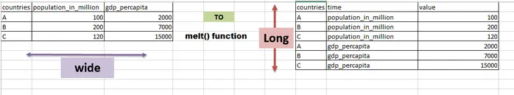
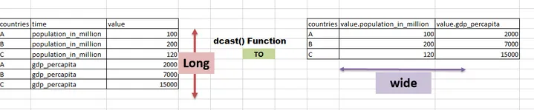
Reshaping
melt()
cast()
reshape()
Notes:
https://www.datacamp.com/community/tutorials/long-wide-data-R
https://www.datasciencemadesimple.com/melting-casting-r/
https://www.datasciencemadesimple.com/reshape-in-r-from-wide-to-long-from-long-to-wide/

Slide 56
Visualisation

Slide 57
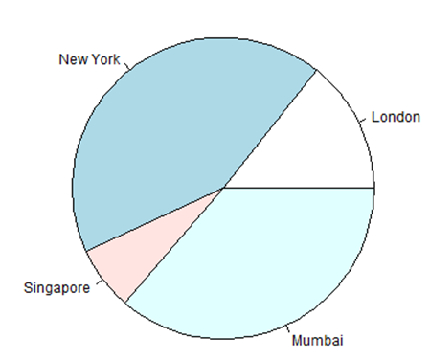
Pie Chart
pie(x, labels, radius, main, col, clockwise)

Slide 58
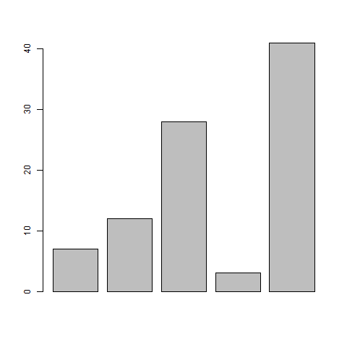
Bar Chart
barplot(H,xlab,ylab,main, names.arg,col)

Slide 59
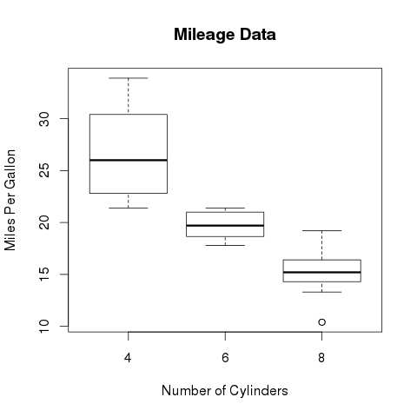
Boxplot
boxplot(x, data, notch, varwidth, names, main)

Slide 60
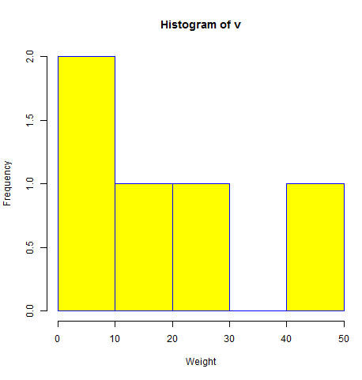
Histogram
hist(v,main,xlab,xlim,ylim,breaks,col,border)

Slide 61
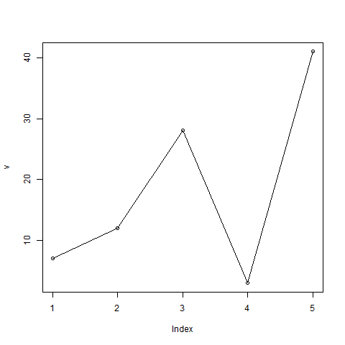
Line Graph
plot(v,type,col,xlab,ylab)
lines(x, y2, type = "l", col = "red")

Slide 62
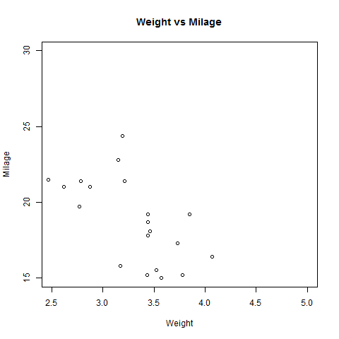
Scatterplots
plot(x, y, main, xlab, ylab, xlim, ylim, axes)
pairs(~wt+mpg+disp+cyl, data = mtcars, main = "Scatterplot Matrix")

Slide 63
Packages

Slide 64
Libraries
tidyverse
dplyr
ggplot2

Slide 65
R package vignettes
Documentation

Slide 66
tidyverse
The tidyverse is an opinionated collection of R packages designed for data science. All packages share an underlying design philosophy, grammar, and data structures.
ggplot2 | DBI | lubridate
dplyr | haven | hms
tidyr | httr | blob
readr | readxl | dbplyr
purrr | googlesheets4 | dtplyr
tibble | googledrive | magrittr
stringr | rvest | glue
forcats | jsonlite | tidymodels
 | xml2
Notes:
install.packages("tidyverse")
library(tidyverse)

Slide 67
pipe %>%
Package magrittr
Basic piping
x %>% f is equivalent to f(x)
x %>% f(y) is equivalent to f(x, y)
x %>% f %>% g %>% h is equivalent to h(g(f(x)))
The argument placeholder
x %>% f(y, .) is equivalent to f(y, x)
x %>% f(y, z = .) is equivalent to f(y, z = x)

Slide 68
tibble
“Tibbles” are a new modern data frame. It keeps many important features of the original data frame. It removes many of the outdated features.
★ http://statseducation.com/Introduction-to-R/modules/getting%20data/tibbles/
Notes:
http://statseducation.com/Introduction-to-R/modules/getting%20data/tibbles/

Slide 69
data.table
data.table provides a high-performance version of base R’s data.frame with syntax and feature enhancements for ease of use, convenience and programming speed.
library(data.table)
DT = as.data.table(iris)
# FROM[WHERE, SELECT, GROUP BY]
# DT [i, j, by]
DT[Petal.Width > 1.0, mean(Petal.Length), by = Species]
# Species V1
#1: versicolor 4.362791
#2: virginica 5.552000
Notes:
Working on large data sets in R - https://www.analyticsvidhya.com/blog/2016/05/data-table-data-frame-work-large-data-sets/

Slide 70
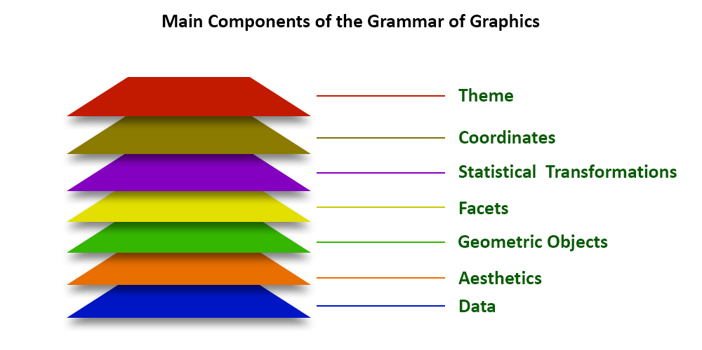
ggplot2
Grammar of Graphics
Building Blocks of layers with the grammar of graphics
Data: The element is the data set itself
Aesthetics: The data is to map onto the Aesthetics attributes such as x-axis, y-axis, color, fill, size, labels, alpha, shape, line width, line type
Geometrics: How our data being displayed using point, line, histogram, bar, boxplot
Facets: It displays the subset of the data using Columns and rows
Statistics: Binning, smoothing, descriptive, intermediate
Coordinates: the space between data and display using Cartesian, fixed, polar, limits
Themes: Non-data link
★ https://ggplot2.tidyverse.org/reference/index.html
Notes:
https://ggplot2.tidyverse.org/reference/index.html
https://www.geeksforgeeks.org/data-visualization-with-r-and-ggplot2/?ref=lbp
https://statisticsglobe.com/graphics-in-r

Slide 71
dplyr
Grammar of Data Manipulation
mutate() adds new variables that are functions of existing variables
select() picks variables based on their names.
filter() picks cases based on their values.
summarise() reduces multiple values down to a single summary.
arrange() changes the ordering of the rows.
★ https://dplyr.tidyverse.org/reference/index.html
Notes:
https://dplyr.tidyverse.org/reference/index.html
https://r4ds.had.co.nz/transform.html

Slide 72
tidyr
tidyr provides a set of functions that help you get to tidy data
tidyr functions fall into five main categories:
“Pivotting” which converts between long and wide forms. tidyr 1.0.0 introduces pivot_longer() and pivot_wider(), replacing the older spread() and gather() functions. See vignette("pivot") for more details.
“Rectangling”, which turns deeply nested lists (as from JSON) into tidy tibbles. See unnest_longer(), unnest_wider(), hoist(), and vignette("rectangle") for more details.
Nesting converts grouped data to a form where each group becomes a single row containing a nested data frame, and unnesting does the opposite. See nest(), unnest(), and vignette("nest") for more details.
Splitting and combining character columns. Use separate() and extract() to pull a single character column into multiple columns; use unite() to combine multiple columns into a single character column.
Make implicit missing values explicit with complete(); make explicit missing values implicit with drop_na(); replace missing values with next/previous value with fill(), or a known value with replace_na().
★ https://tidyr.tidyverse.org/reference/index.html
Notes:
https://tidyr.tidyverse.org/reference/index.html
library(data.table)
DT = as.data.table(iris)
# FROM[WHERE, SELECT, GROUP BY]
# DT [i, j, by]
DT[Petal.Width > 1.0, mean(Petal.Length), by = Species]

Slide 73
readr
readr provides a fast and friendly way to read rectangular data
★ https://readr.tidyverse.org/reference/index.html
Notes:
https://readr.tidyverse.org/reference/index.html

Slide 74
stringr
stringr provides a cohesive set of functions designed to make working with strings as easy as possible
★ https://stringr.tidyverse.org/reference/index.html
Notes:
https://stringr.tidyverse.org/reference/index.html
https://www.rdocumentation.org/packages/stringr/versions/1.4.0
https://r4ds.had.co.nz/strings.html

Slide 75
Data Science

Slide 76
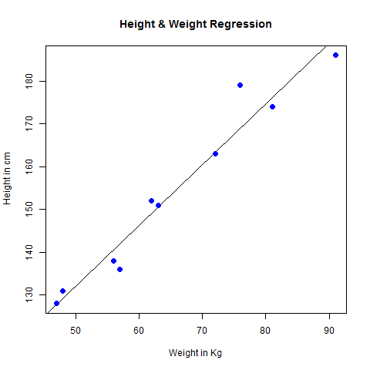
Linear Regression
lm(formula,data)
formula is a symbol presenting the relation between x and y.
data is the vector on which the formula will be applied.
x <- c(151, 174, 138, 186, 128, 136, 179, 163, 152, 131)
y <- c(63, 81, 56, 91, 47, 57, 76, 72, 62, 48)
relation <- lm(y ~ x)

Slide 77
Multiple Regresson
lm(y ~ x1 + x2 + x3...,data)

Slide 78
Logistic Regresson
glm(formula, data, family)

Slide 79
Decision Tree
The R package "party" is used to create decision trees.
install.packages("party")
ctree(formula, data)
library(party)
ctree( nativeSpeaker ~ age + shoeSize + score,
data = input.dat)

Slide 80
Random Forest
The R package "randomForest" is used to create random forests.
install.packages("randomForest)
randomForest(formula, data)
library(party)
library(randomForest)
randomForest(nativeSpeaker ~ age + shoeSize + score,
data = readingSkills)

